Slide 1
KPL RAG Monthly Meeting
General Progress and Stategy
SATURDAY, APRIL 06, 2024

Slide 2
Preamble, Purpose, Intent & Mission
Preamble
KPL RAG formed on the 17 Feb 2028
Arising from a petition/survey undertaken where a large proportion of home owners dissatisfied and suggested a requirement for an action committee ( 80% of 48 homes = 38 homeowners approximately)
Purpose
To provide a platform to unify homeowner matters and address common challenges and explore common opportunity creating a united homeowner front to expedite matters of common interest
Intent
To work in collaboration with all other parties inclusive stakeholders such as Magic Breakaways, Legacy. Golf Club etc to achieve the common goal of an improved KPL
To improve transparency to support decision making
To hold Board and Representatives accountable
To identify improvement areas and to progress these together with the management teams and the Board eg Paddle Courts etc.
MOTTO
BUILD BACK BETTER
COMMITTEE
VITS, SELWYN, PEDRO, TONY

Slide 3
Messages - Important
Find ways to improve home owner participation including responding to requests
Members Encouraged to use Whatsapp lines
Owners encouraged to phone each other – should not be afraid to call each other - what happened to my neighbor
Bottom mine – Last six odd weeks spent drafting various letters to HOA with mixed but to some extent encouraging results however concern remains that on the key matters involving finance and costs these do not appear to be addressed
Agreed Next Steps ( Post meeting note)
Develop and send Rag Membership form
Call meeting with HOA reps
If need be call meeting with HOA reps via MOI
Formal note to restart HOA meetings ( three monthly)
Vits to issue structures letter to Neil to get confirmation of various parties etc
Thanks to Ryan for special effort being put into and acknowledged by many owners – Well done Ryan
Cleaning Survey to be submitted
Matter of additional props becoming available – How does this work and where is money
Discuss mobitech with KPL and Home Owners
Water charges
Each to check insurance cover while notes continue
New matter of Laundry - POA

Slide 4
Matters Arising - KPL RAG- 17 Feb 2024 meeting 1/2024 Meeting actions & Next Steps ( at time up to 29 participants – Zoom) Partial recordings available on request
Meeting setup and Organization ( too long – Target 90 minutes in future)
Members prefer both in person and “virtual”
Seek professional version of zoom
Home owner get together – Proposed at each monthly meeting with a Quarterly function meeting. First one proposed for April 27th weekend. Planning committee required.
References and recommendations – Whatsapp tool seems to be preferred.
Other Matters
Cornel not available – VM to discuss with Andre.
Set up a cleaning complaints line – subcommittee to address cleaning quality matters
Suggestion – Work out our contributions to value in $$$ to KPL
Cleaning increase contingent on cost justifications and quality improvement plan. Letter to be drafted and Sent. Action vits
Accountability = items missing.
Checklist on entry and return
Linen checklist.
Arrival dusting.
Laundry
Demand immediate action.
HOA meeting status and requests from HOA for formal meeting – Action tony
Letter to be drafted and pass onto representatives. Group require a meeting of HOA( formal before) the board meetings
Chair – Voting in next week and appointment to be made on Group Whatapp.
Frequency – max 1 hour – monthly. Chair to schedule for balance of year after votes taken.
Survey – Extend by 1 week for all new members joining. 40 submissions. Vits to prepare top 5 concerns and proposals to resolve. Send to RAG and after comments to KPL Management for responses. Action close date end Feb 2024.
Post meeting messages notes etc - To have three groups – RAG Matters, Residents Social & Complaints

Slide 5
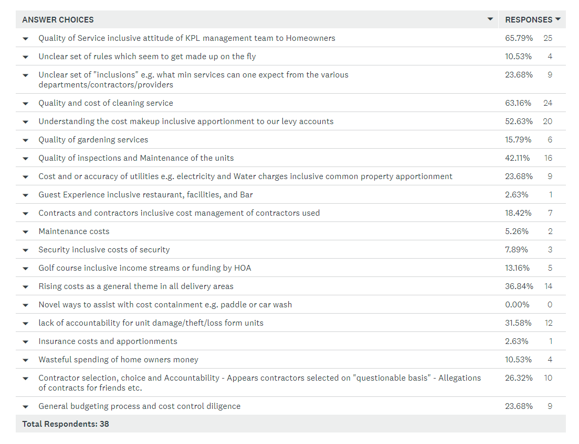
RECAP OF KEY HOME OWNER ISSUES - Q 14 - Please Select the Top Five Priority areas for you (Note this will help us focus effort - Please select 5 only - Others will be addressed later)
1
2
3
4
5

Slide 6
ACTION1 - Quality of Service and Attitude to Home Owners
PROGRESS – Various letters sent – We have received some feedback but the usual delay tactics appear to be in play. Pass between Chairperson, GM, Board etc.
RAG is not accepted
KPL - STRATEGY IS
Listen to us but not really act as one would expect from a Non Profit Board
Split us into Sectional Title and Shareblock – RAG rejects notion
Provide better points of contact and communications – Mail went out with various new contacts
Points of order ignored and replaced HOA with a non binding informal Communication Meeting.
NEXT STEPS
Signed RAG membership forms….Urgent Action please form all RAG supporters approximately 80 which is
Demand meeting with HOA Reps
Continue to collect data and statistics
Force the issue of Votes and HOA via Ombud or CIPC as MOI is clear
Push for a revised home owners manual
Push for better understanding and mandates on our board representatives
MEETING NOTES
RAG Forms to be issued ASAP.
Meeting with Tozer and Toplis.

Slide 7
ACTION 2 - Cleaning Contract
PROGRESS - RAG Managed to get the cost increase changed but the answers to how this comes about and more importantly how to improve quality remains Open – Ryan appears to be trying and positive feedback. Announcement for permanent residents and private cleaners pending.
KPL - STRATEGY IS
TO PUT US DOWN TO COMPLAINING BUNCH
AS KPL ARGUES SERVICE IS EXCELENT WITH ODD CONCERNS ONLY.
DIVIDE US BY GIVING EACH A DIFFERENT STORY
NEXT STEPS
RAG - Home owners to complete Survey
RAG - Homeowners to complete a min expectations document for each type of cleaning and submit as they are not going to give details of what is included
RAG - Home owners to report cleaning challenges and damages on the whatsapp group
RAG - Homeowners to consolidate concerns on a monthly basis and demand response to what has been done
MEETING NOTES
LAUNDRY QUESTION – VM SENT A LETTER, SYSTEM NOT WORKING.
BASIS of changing. WHY so many or daily changes. Policy…..
Training of cleaning staff.

Slide 8
ACTION 3 – HOA Meetings
PROGRESS – KPL HOA reduced to 1 formal meeting per year AGM – Major concern as accounts and formal actions can only be elevated 1/year.
KPL - STRATEGY IS
Provide Alternate Communication Meetings
HOA representatives have simply been Lacking and refused to meet with RAG
All points of order raised have been ignored
Deliberate mixing up of Sectional and Shareblock and not allowing us 10% right to call special HOA
NEXT STEPS
RAG – Demand meeting with HOA Reps
RAG – Escalate MOI Clause 14 to CPIC for resolution
RAG – To draft prescriptive mandates to both Sectional and Shareblock members – We tell them what they allowed to do or not do without our consent – Will include approval of budgets and expenditure.
MEETING NOTES

Slide 9
ACTION 4 – REVENUE SIDE OF EQUATION
PROGRESS – Various Ideas Proposed including Paddle, Spa Restaurant etc.
KPL - STRATEGY IS
Invited KPL to share ideas but non - forthcoming
NEXT STEPS
Develop Business cases and present at future HOA meetings.
MEETING NOTES

Slide 10
ACTION 4 – MATTER OF INSURANCE
PROGRESS – Letter Sent and Response received.
KPL - STRATEGY IS
Group insurance from Marsh and various underwriters
One fits all in summary
NEXT STEPS
Individual owners who have increased investment through upgrades will need to submit a formal note to ensure that your home value is adequately captured
Request a more formal response to insurance in terms of a schedule and excess etc
MEETING NOTES
Valuator - ????
Letters – value of house??

Slide 11
ACTION 4 – MATTER OF GOLF CLUB
PROGRESS – Letter Sent and Response received requesting time to answer questions.
KPL - STRATEGY IS
That this area belongs to the golf club and this is a separate entity
NEXT STEPS
We as RAG argue that as long as HOA funds this, This committee is accountable to RAG
Revenue and costs make no sense as loss continues into circa .75-1 Million per annum.
MEETING NOTES

Slide 12
KPL Shareblock – owner of the entire facility
KPL HOA ( BOARD)
Shareblock ( Board)
3 seats – Voting
52 votes per shareblock unit
Styles, Adams, Charl
Ideally this structure works provided HOA
Members execute mandate on behalf of HOA members.
HOA Representatives don’t seem to share Home owner concerns or believe that all is well
Sectional Titles
2 seats – Voting
Raymond Tozer
Nigel Toplis
52 votes per home
Developer – Magic Breakaways
4 seats
We can continue to ask/request/force
But bottom line comes down to mandates of HOA Representatives – In the first instance they should get Mandates
Legacy
Management
Contractors
RAG
Both
Financial Management
Lack of Respect for Owners
Force accountability and transparency which is our right despite complex structure above as we own KPL

Slide 13
General and others
Meeting Ends

Slide 14
Previous Home Owner Shares and presnetations
From meeting

Slide 15
Progress with Survey ( Poor completion rates & could be skewed results) Must try and get “Happy or satisfied” People to also complete
49 respondents
57 homes Represented as a few owners have multiple units
9 permanent residences – not rented but their homes
29 renting out ( 57% of these rent out privately)
81% not active in home organization ( sometimes or never attended)
37% say they attended once but felt that meetings ineffective of Bull Dozed.

Slide 16
Q4: At the moment members have no structured manner to approach the concerns of owners specifically either sectional title or share block.
Answered: 36 Skipped: 2
Home owners in general happy about
Insurance
Reception services
Security patrols
Gardens
Q46
Most Owners Believe KPL/Legacy appear
To focus on their revenue streams
With little focus on home owners
( 59% with Balance unsure)
Q44 – 62% agree that all cost increases
must stop until justifications

Slide 17
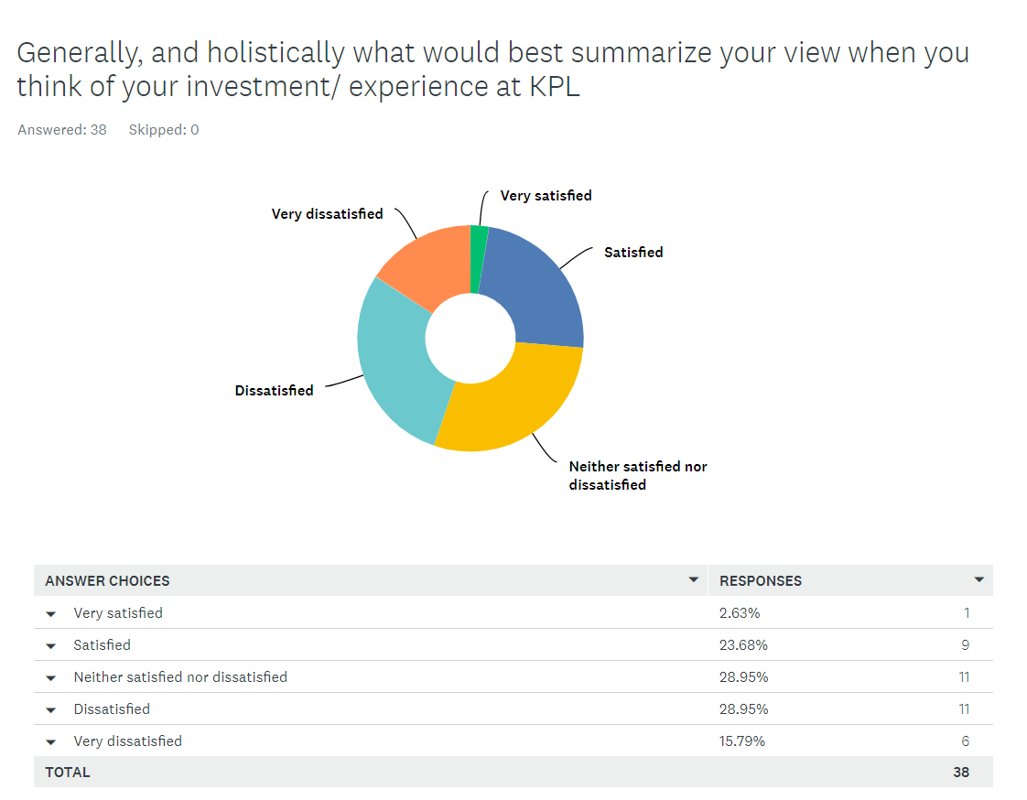
26 % are happy
29 % are on the fence
45% are unhappy
With from question 12
40 just holding on hoping things
Will improve
20% had enough and selling
To get out of KPL

Slide 18
Q10: General satisfaction with the current management at KPL inclusive our HOA members on the board (Pick all relevant to you)
Answered: 37 Skipped: 1

Slide 19
Q10: General satisfaction with the current management at KPL inclusive our HOA members on the board (Pick all relevant to you)
Answered: 37 Skipped: 1
ANSWER CHOICES | RESPONSES
None of the below - I am satisfied with the management at KPL | 2.70% | 1
They appear to be making unilateral and poorly consulted decisions | 45.95% | 17
Decisions are concerning in terms of our interest as home-owners or cost consideration | 64.86% | 24
Home Owner Reps on the board need a clear mandate from us before agreeing on our behalf | 56.76% | 21
Too much power given to the general manager without proper oversight | 70.27% | 26
Too much power given to the board without proper oversight | 54.05% | 20
Concerning and questionable use of HOA funds | 54.05% | 20
TOTAL |  | 129
2
3
1

Slide 21
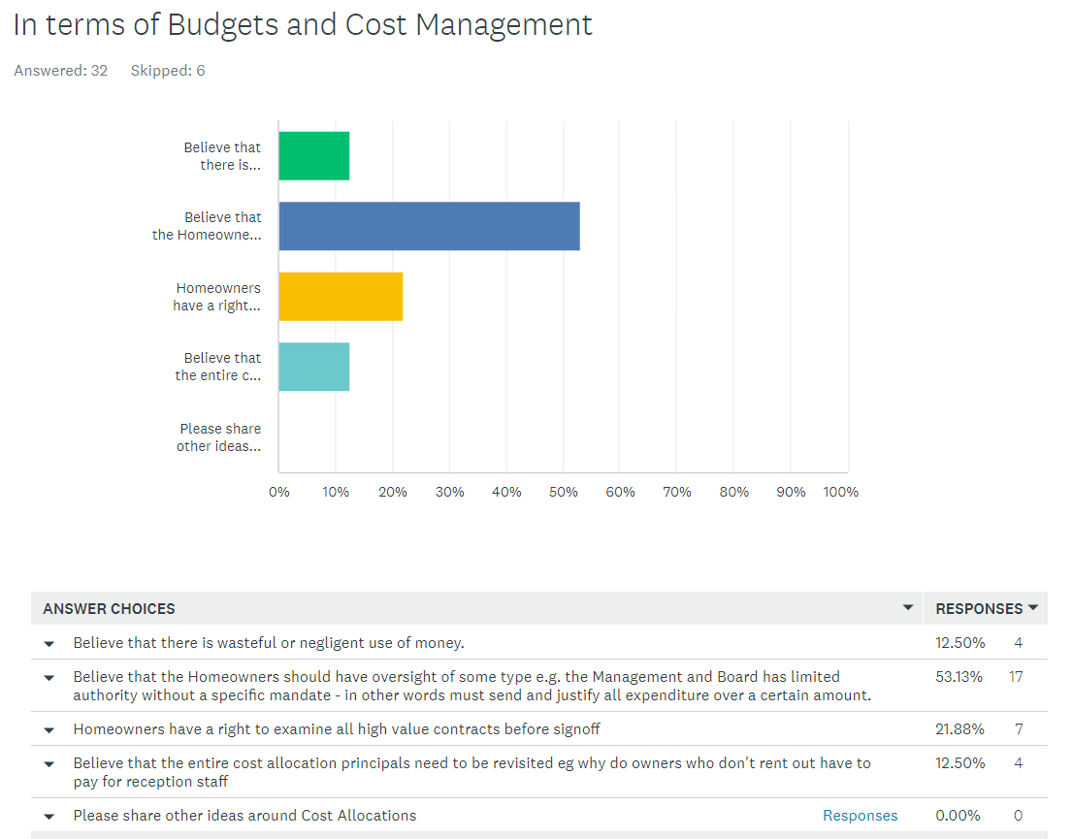
3
1
2
3

Slide 22
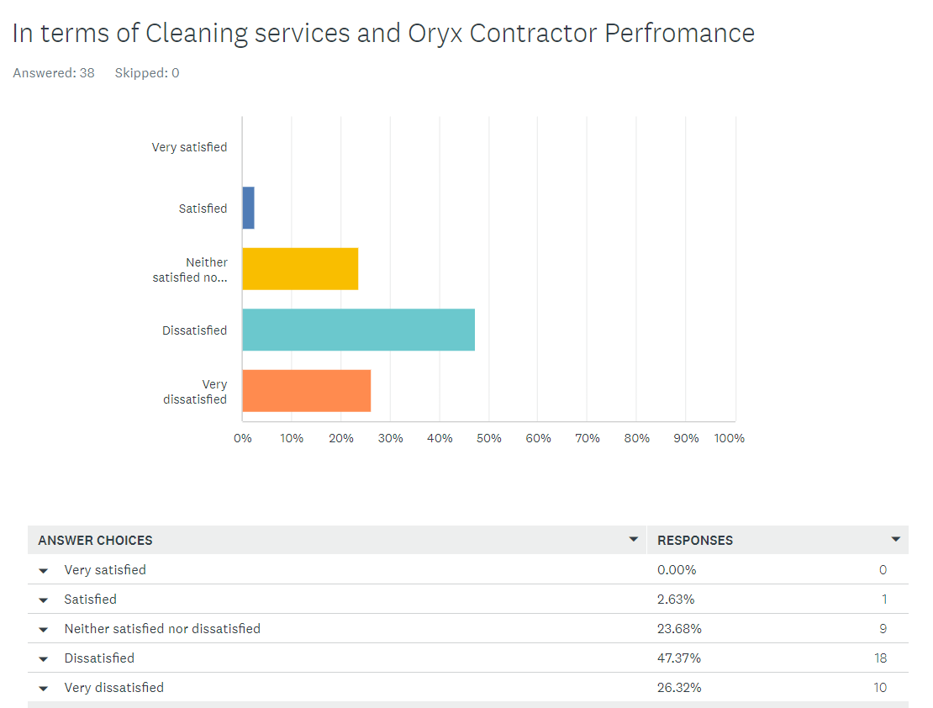
74% Unhappy with Cleaning
3
1
2

Slide 23
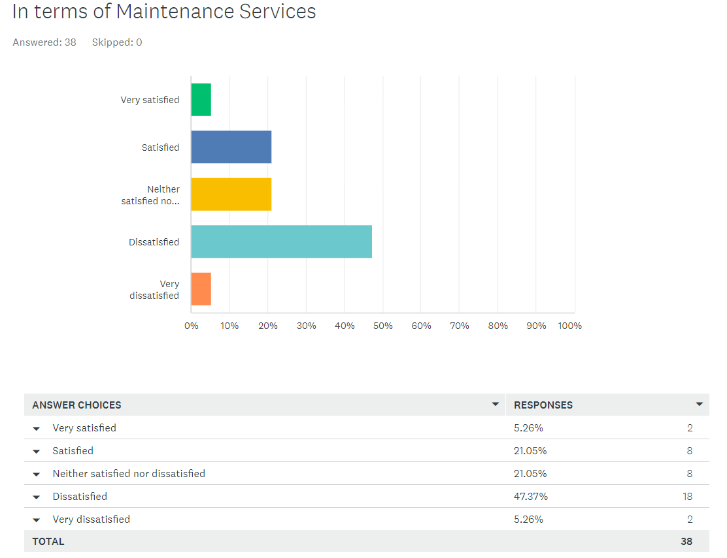
52% Unhappy with Cleaning

Slide 24
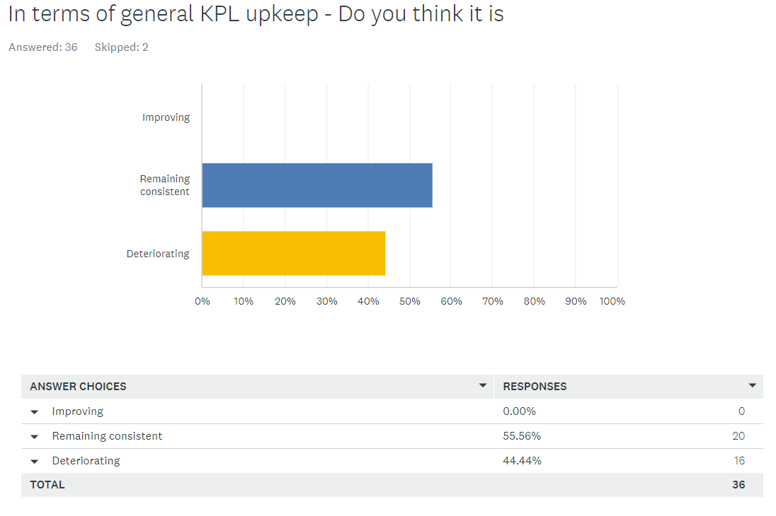
Concern that zero %
See KPL as improving
As RAG we need to support
Progressive ways
To Build Back Better

Slide 25
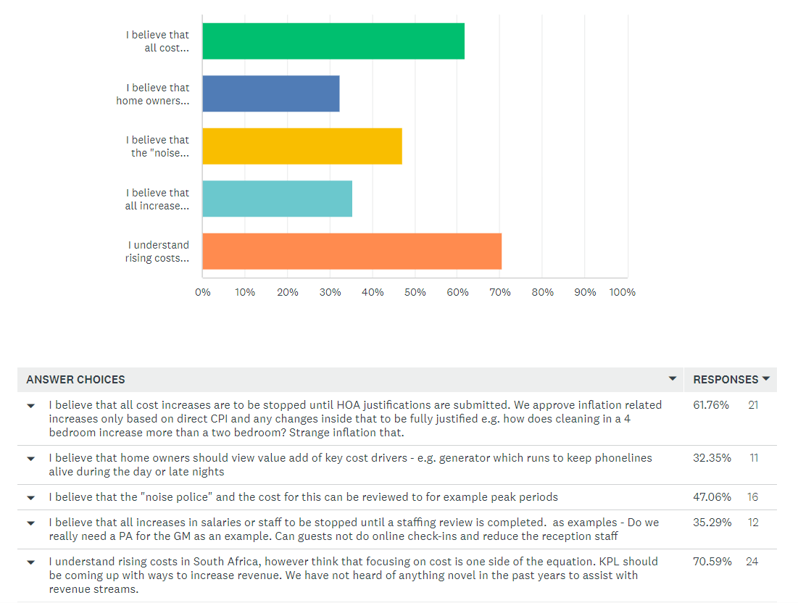
Novel ways
On line bookings
Noise police
RAG helps find guests by empty room details

Slide 26
KPL RAG Rules of Engagement
s
Group core activity is likely to be emotionally biased, so members tolerance on the one hand and restraint on the other is respectfully requested.
The chair will be allowed to use phases like
Hands up on electronic for interruption
Please allow speaker to finish
Out of order
Point of redirect ( when member either strays or belabors point)
Chair Role – To maintain meeting structure and coordinate only the discussions. All views of the chair are his/her own as a homeowner themselves.
Meeting frequency – once a month but adhoc as requested will be entertained.
Unregistered advocacy group aimed to improve homeowner experiences at KPL and not limited to any matter whether direct or indirect to ownership at KPL.
Only Owners of homes in KPL sectional title, share block and time share allowed to be members
Respect rights of all stakeholders including service providers and the developer/operators (legacy at time of formation) to participate, ask questions or simply observe
No Membership forms or fees payable for membership
Principal of 1 vote for home/unit shall generally apply
All communications in the English language however where relevant other languages might require translators – Google translate to be used.
Minutes will generally not be kept but action lists developed.

Slide 27
Action Item 1
Quality of Service and Attitude to Home Owners
VARIOUS LETTERS SENT – SOME AREAS OF IMPROVEMENT BUT KEY CONCERNING ISSUES REMAIN
KPL – HOA Failure to recognize RAG – Suggest formal Mandate and Membership forms signed up by homeowners
Points of order raised – KPL argues that the HOA and most recently home owners meetings are simply comms meetings
– Suggest we after mandating RAG, Send a formal note with 80 odd home powners
To demand more formal HOA meetings
Continues to Confuse voting rights – The HOA and MOI are clear, there is no distinction in the types of members let alone the so called sectional title.
- Neil continue to argue that there are two groups even though his letter explaining voting Rights are clear
- Suggest we raise this at the Ombud and CPIC as this is not to my mind legal
Called for recognition of three stakeholder groups, RAG, Prvate Rental Agents and Private residences – Not Recognised
Called for meetings with HOA reps – To date all have simply ignored requests
Home owner rules – Owners manual Update – Still outstanding

Slide 28
Action Item 1…contd
Quality of Service and Attitude to Home Owners
Request for a formalized complaints process – No Progress
Request to share security statistics – No Progress
Staff satisfaction survey – No Progress
Conflict of interest policy – Interesting development that MOI allows board members to enter into business with HOA. This should not be allowed and needs to be an area of focus
Matter of formalized tender committee for large spend areas etc – No Progress
Private and domestic cleaners – Approved as long as for personal use only. Awaiting formal note

Slide 29
Action Item 2…
Quality of Service Cleaning
RAG managed to get the increases reduced but still await the details. Spoken to Neil on numerous occasions and yet details of what included excluded are not forthcoming
Also seems they have appointed a RYAN as the single point of contact
Neil was surprised to hear that homeowners couldn’t speak with Cornel and promised to address – we await feedback
Matter of the still Room brand – No Tender process followed – Suggest we insist that this is done as a matter of Priority
KPL Argue that the service and customers reports are very good and no intervention required
Neil Agreed to conduct a survey which disappointingly was a simple email/letter sent out
Suggest as RAG we all complete a standardized template and submit with copies to RAG
Matter of Laundry – KPL refuse to engage on this and ignore messages
Vits - Explored a solution called MOBITECH which would cost a home owner 200-400 depending on takeup. Allows checklists to be submitted, photos of damages, vidoes etc. Importantly damages can be photographed and loaded onto the house profile. WHAT IS INTEREST TO EXPLORE.

